Slide 1
TASK_- 2
File created on: 6/23/2020 8:01:15 AM

Slide 2
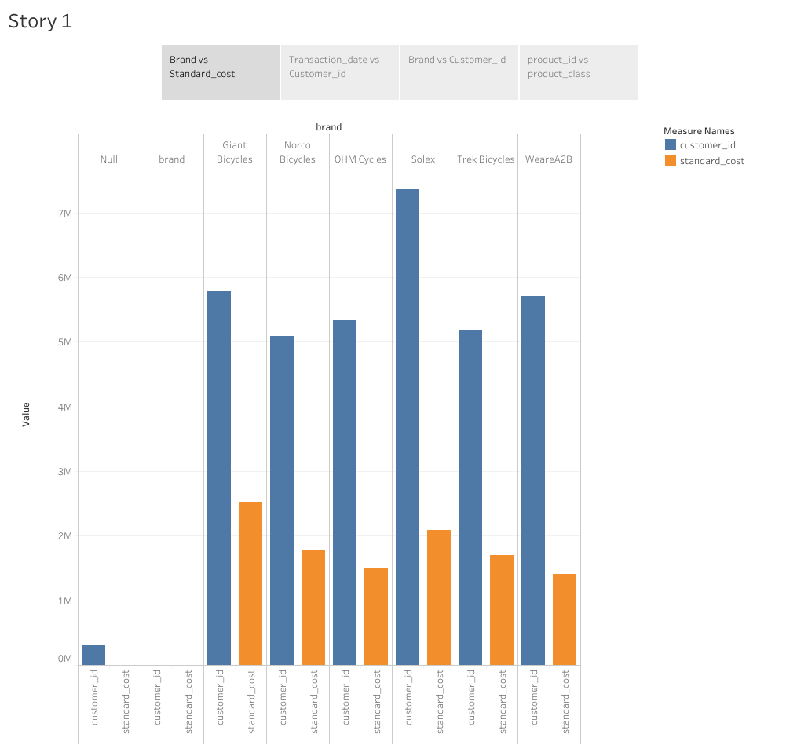

Slide 3
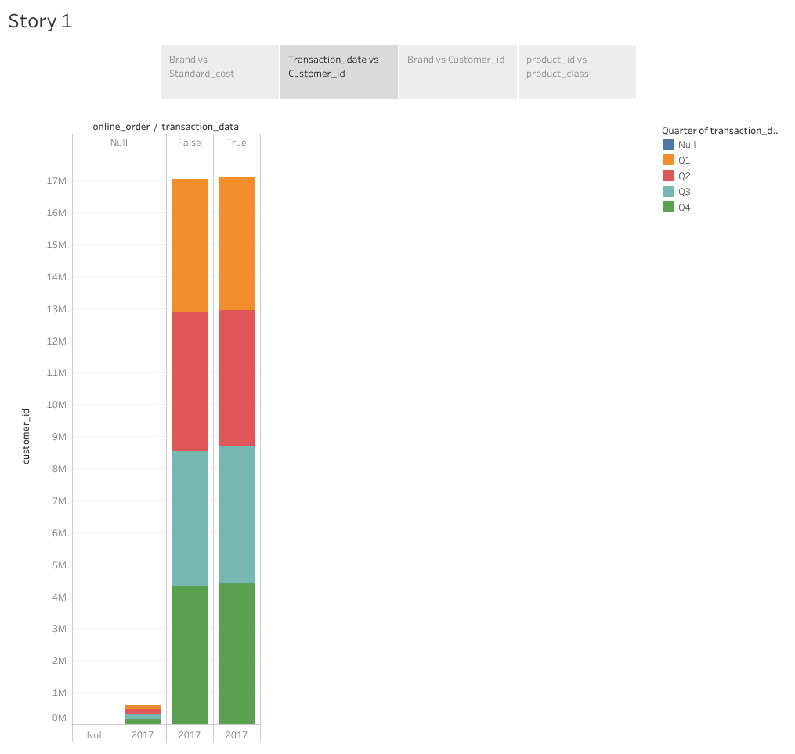

Slide 4
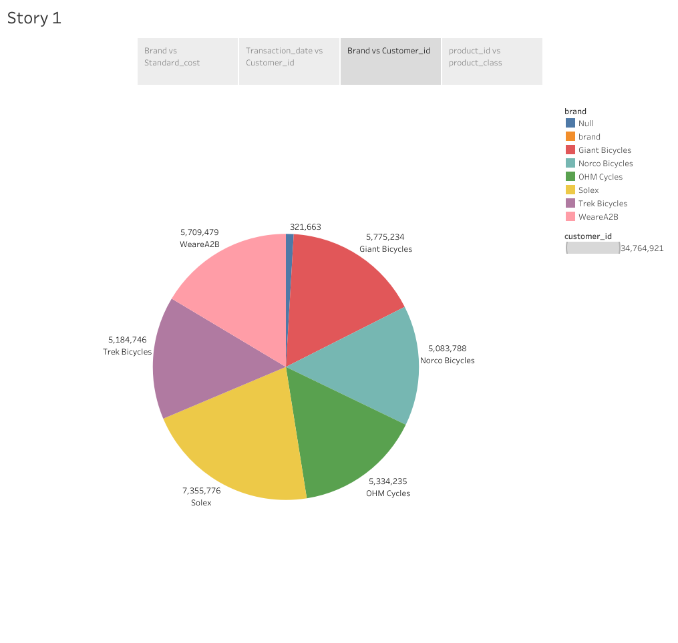

Slide 5
